Slide 1
The history of EJB framework
MASANORI KAWAI
APTECH 27th/Oct/2010

Slide 2
Contents
What is EJB
EJB 1.1 (RMI-IIOP)
EJB 2.0
EJB 3.0/3.1
Java Persistent API(O/R Mapping Technology)

Slide 3
What is EJB
(Enterprise Java Bean)
It is one of the component framework.
Sun has been developing with Servlet/JSP
J2EE v1.2 (Dec, 1999)
  Enterprise JavaBeans Specification (EJB), Version 1.1
  JavaServer Pages Specification (JSP), Version 1.1
  Java Servlet Specification, Version 2.2
  JDBC API, Version 2.0
  Java Naming and Directory Interface Specification (JNDI), Version 1.2

Slide 4
J2EE v1.2 (continue)
  Java Message Service (JMS), Version 1.0.2
  Java Transaction API (JTA), Version 1.0.1
  Java Transaction Service (JTS), Version 0.95
  JavaMail API Specification Version 1.1
  JavaBeans Activation Framework Specification (JAF), Version 1.0

Slide 5
Why servlet is not enough?
Application Servers are the same as Servlet container.
Servlet specification has only the definition for handling interface of HTTP.
We could not create Thread class in Servlet GET and POST in J2EE 1.4
Servlet does not defined any programming model.

Slide 6
List of Application Server with EJB
JBoss AS(Red Hat Enterprise)
WebLogic(Oracle)
GlassFish(Oracle)
Apache Geronimo and OpenEJB

Slide 7
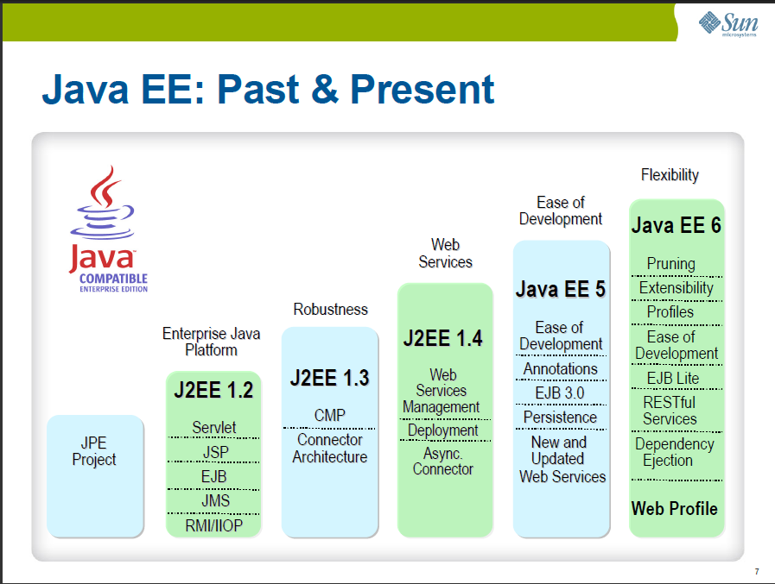

Slide 8
EJB 1.1(2000)
The Enterprise JavaBeans architecture is an architecture for component-based distributed computing.
Enterprise beans are components of distributed transaction-oriented enterprise applications.
  Session Bean(shall)
    Stateless Session Bean
    Statefull Session Bean
  Entity Bean(Option)

Slide 9
Session Beans(Stateless)
Stateless Session
  Only while client side invoke methods in Session Beans, EJB container make instances of Beans
Handle Object
EJB Container
Client1
Stateless EJB
Invoking method
Client2
Stateless EJB
Client3
Stateless EJB
Invoking method
Client4
Stateless EJB

Slide 10
Session Beans(Stateless)
Stateful Session
  While client side keep their sessions in connections, EJB container keep instances of Beans
Handle Object
EJB Container
Client1
Stateless EJB
Client2
Stateless EJB
Client3
Stateless EJB
Client4
Stateless EJB

Slide 11
RMI-IIOP
'RMI-IIOP' (read as "RMI over IIOP") denotes the Java Remote Method Invocation (RMI) interface over the Internet Inter-Orb Protocol (IIOP)
IIOP delivers Common Object Request Broker Architecture (CORBA) distributed computing capabilities to the Java 2 platform
OMG(Object Management Group) defined CORBA is one of the exchange methods(protocols) of objes.

Slide 12
Early 3-tire Architecture(J2EEv1.2)
Web Application Server
(EJB containter)
COBOL with Legacy DBM
Browser
Session Bean
Calling Methods
Entity Bean
RMI-IIOP
Legacy DBM

Slide 13
What’s problme?
No scalability.
Tight-coupled among components.
EJB 1.1 Entity Beans could not handle other Java beans directly
Entity Beans did not have clear specifications for O/R Mapping

Slide 14
EJB 2.0 (Sep, 2001)
Add Message-Driven Bean
Improve Container Entity Beans
  Add Container Management Relationship
  Introduce EJB QL

Slide 15
Message-driven Beans
Receiving JMS messages can invoke EJB
  Session Beans only consider HTTP connections from Browser
  Some Java desktop applications do not use HTTP connections
  This beans is useful in frontend for both Web Client Applications and Desktop Applications

Slide 16
4-tire Web Application Model(J2EEv1.4)
Servlet/JSP
Container Server
EJB Container Server
COBOL with Legacy DBM
RMI-IIOP
Browser
Servlet/JSP
Message-Driven Bean
Session Bean
Entity Bean
Entity Bean
JMS message
JMS Client
Handle Session on WebService
JDBC
Microsoft SQL

Slide 17
What’s problem?
This architecture was too complicated.
CMP Entity Bean did not have good performance
Development of Entity Bean was very difficult
If DB structure had been changed a little, programmer should maintain the Java source code and xml configuration.
Nobody did not use EJB framework
  Everyone used other Servlet-base framework
    Spring Framework
    Structs

Slide 18
EJB 3.0/EJB3.1lite
To integrate Web Service
To define EJB sub-specifications for client sides(EJB 3.1 lite)
To integrate war(Web Archive) and ear(EJB archive) easily.

Slide 19
Entity Beans
Currently Pruning Beans
To use the Java Persistent API
Suppression
  Container Managed Persistent Beans(CMP)

Slide 20
Java Persistent API (JPA)
Mechanism for managing relational data in applications using Java objects.
  JPA uses annotations for representing relationship between multiple objects
  JPA has the Java Persistent Query Language(JPQL) which makes queries against entities accessed in a relational database
Java SE and EE, both support JPA for accessing a relational database.
We can easily handle table objects through POJO(Plan Old Java Object)

Slide 21
Predefined Entity Annotation
// Table name” CONTACT”
@Entity
@Table(name = "CONTACT")
// Definition of methods for each query(JPLQL) for “findAll”
@NamedQueries({@NamedQuery(name = "Contact.findAll",
query = "SELECT c FROM Contact c"),
// “find(PersonId)”
@NamedQuery(name =Contact.findByPersonId", query = "SELECT c FROM Contact c WHERE c.personId = :personId"),
// “find(Cname)”
@NamedQuery(name = "Contact.findByCname", query = "SELECT c FROM Contact c WHERE c.cname = :cname")})

Slide 22
Class and field
public class Contact implements Serializable {
private static final long serialVersionUID = 1L;
// PersonId(int type, primary key, identity, not null,
// column name is PERSON_ID)
@Id
@GeneratedValue(strategy = GenerationType.IDENTITY)
@Basic(optional = false)
@Column(name = "PERSON_ID")
private Integer personId;
// Cname(string type, column name is CNAME)
@Column(name = "CNAME")
private String cname;
public Contact(Integer personId) {this.personId = personId;
}

Slide 23
Setter and Getter for member fields
// getter for personid
public Integer getPersonId() {
return personId; }
// setter for personid
public void setPersonId(Integer personId) {
this.personId = personId; }
// getter for cname
public String getCname() {
return cname; }
// setter for cname
public void setCname(String cname) {
this.cname = cname; }
}

Slide 24
4-tire Application Model(JEEv1.5)
Servlet/JSP Container
COBOL with Legacy DBM
EJB Container
Browser
Servlet Web Application
Session and
Message-Driven Bean
with JPA
Mainframe JDBC
JMS message
Microsoft SQL
Handle Session on WebService
MS JDBC
JMS Client
on EJB client

Slide 25
4-tire Application Model in example(NetBean v6.8)
EJB Container
Browser
JMS Web Client Application
Session and
Message-Driven Bean
with JPA
JMS Client
on EJB client
MS JDBC
Microsoft SQL

Slide 26
Thank you for your attention

